Slide 1
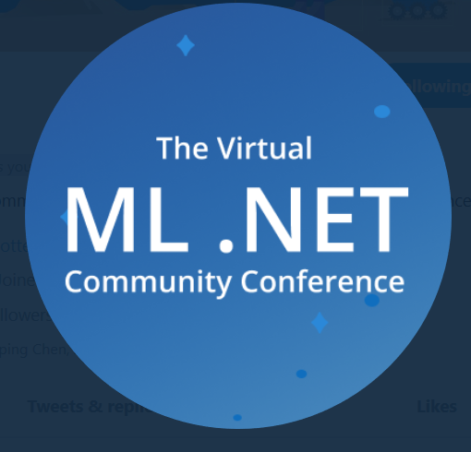
COVID-19 Exploratory Data Analysis
A Primer on .Net DataFrame and ML.net
Praveen Raghuvanshi

Slide 2

Introduction
Cloud Architect @ Harman
Domain: Audio, Video, Control
Area of Expertise: Cloud, Distributed computing
Area of Interest: AI/ML, Cloud and IoT
Location: Bangalore, India

Slide 3
Acknowledgements
John Hopkins University CSSE- Dataset
Akshay Sb – Python Visualization
Alexander and Jon – Organizers
Excella and Wintellect - Sponsors

Slide 4

COVID-19
As per Wiki…
“Coronavirus disease 2019(COVID-19) is an infectious disease caused by severe acute respiratory syndrome coronavirus 2 (SARS-CoV-2).
The disease was first identified in 2019 in Wuhan, the capital of China's Hubei province, and has since spread globally, resulting in the ongoing 2019–20 coronavirus pandemic”
Image Source: https://www.theweek.in/news/india/2020/03/29/coronavirus-will-see-its-end-soon-say-renowned-astrologers.html

Slide 5
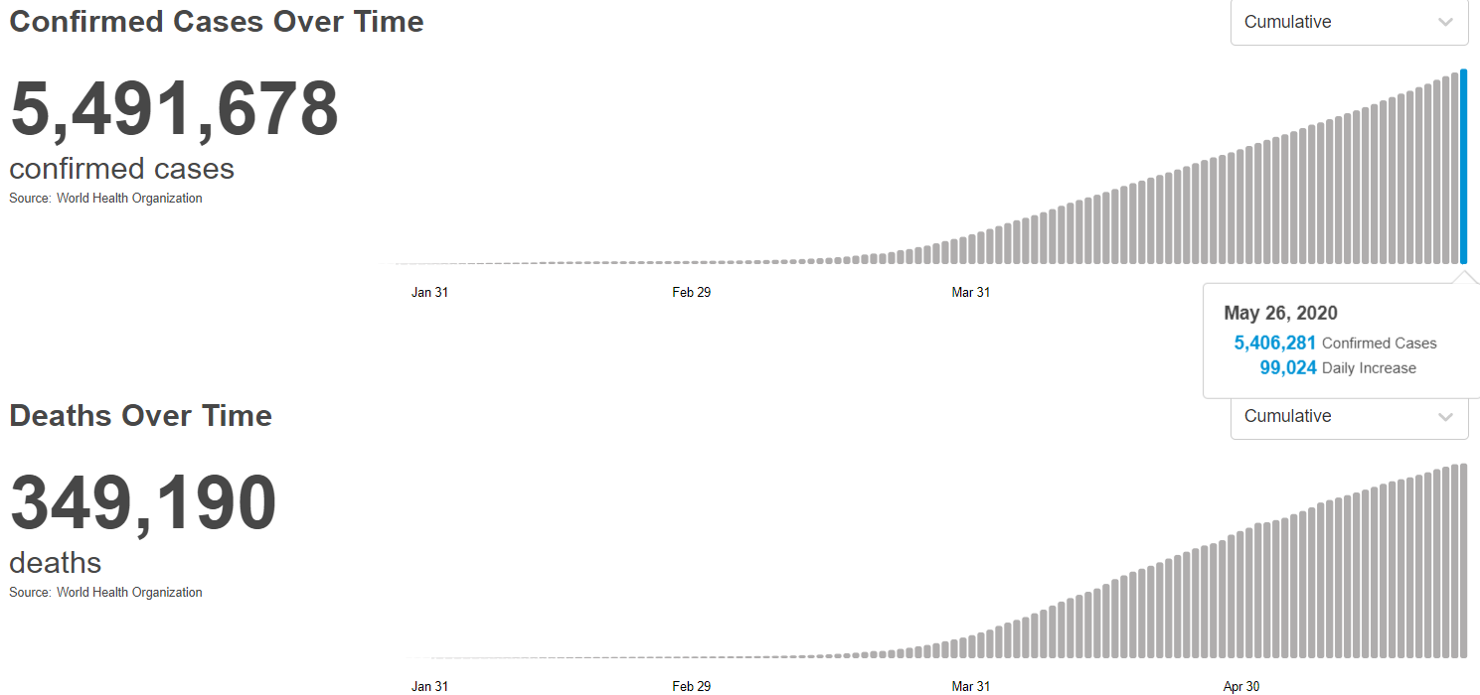
COVID-19 (Statistics) : May 26, 2020
Source: https://covid19.who.int/

Slide 6

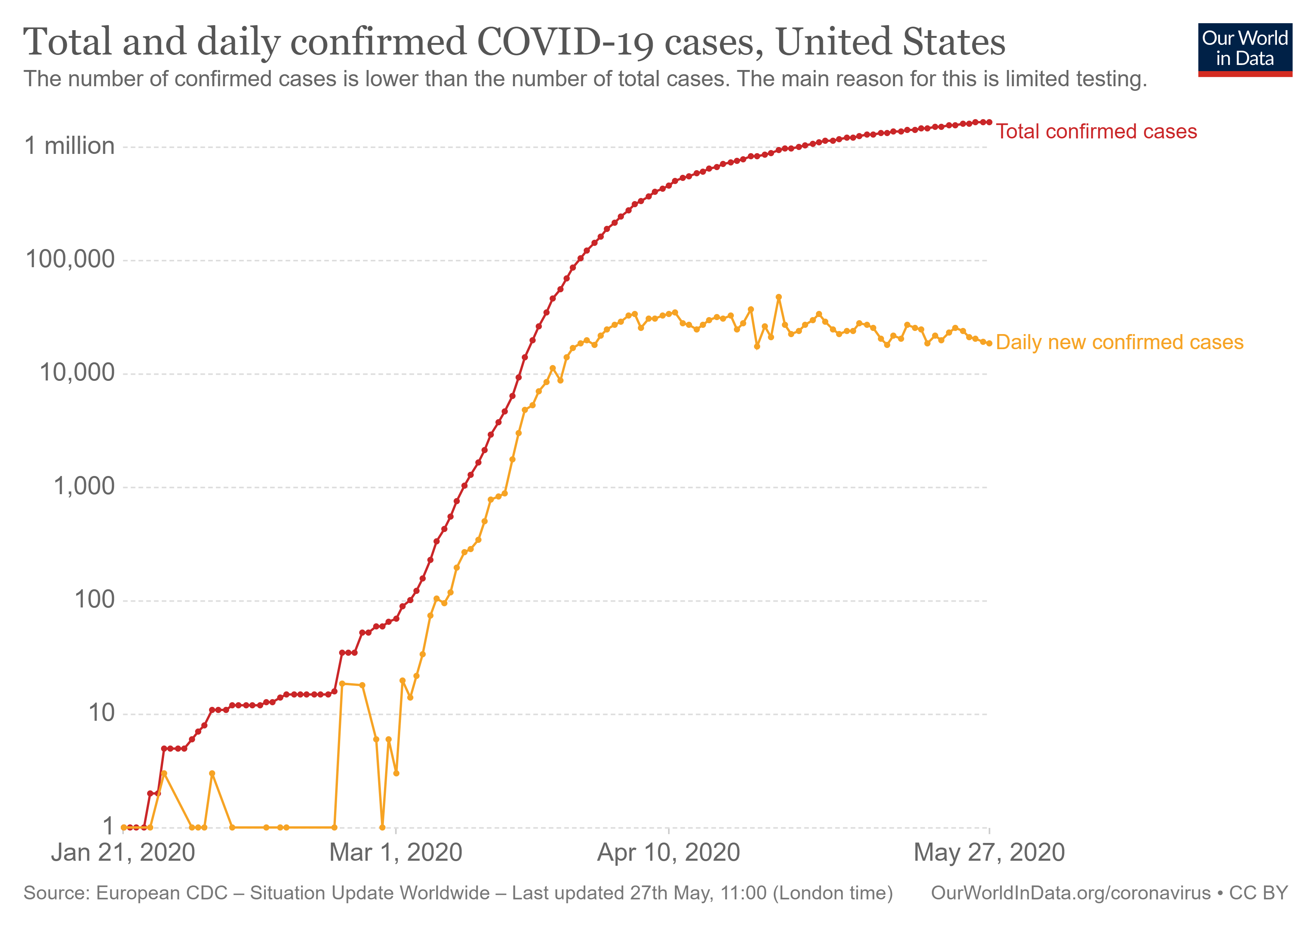
COVID-19 (Statistics) : May 26, 2020
Source: https://slides.ourworldindata.org/2020_pandemic/2020_pandemic#/title-slide

Slide 7
Exploratory Data Analysis - EDA
As per Wiki…
“In statistics, exploratory data analysis (EDA) is an approach to analyzing data sets to summarize their main characteristics, often with visual methods.
A statistical model can be used or not, but primarily EDA is for seeing what the data can tell us beyond the formal modeling or hypothesis testing task.”

Slide 8

EDA Contd…
Buy a house
No of bedrooms
Type(Apartment, Villa)
Locality
Crime rate

Slide 9
Time Series Analysis
As per Wiki…
“In statistics, exploratory data analysis (EDA) is an approach to analyzing data sets to summarize their main characteristics, often with visual methods.
A statistical model can be used or not, but primarily EDA is for seeing what the data can tell us beyond the formal modeling or hypothesis testing task.”

Slide 10

Programming Languages
Source: https://insights.dice.com/2019/10/24/tiobe-top-eight-top-ten-open/

Slide 11
Quiz : Type of ML
Is this A or B?
How much – or – How many?
How is this organized?
What should I do next?
Is number a Armstrong?

Slide 12
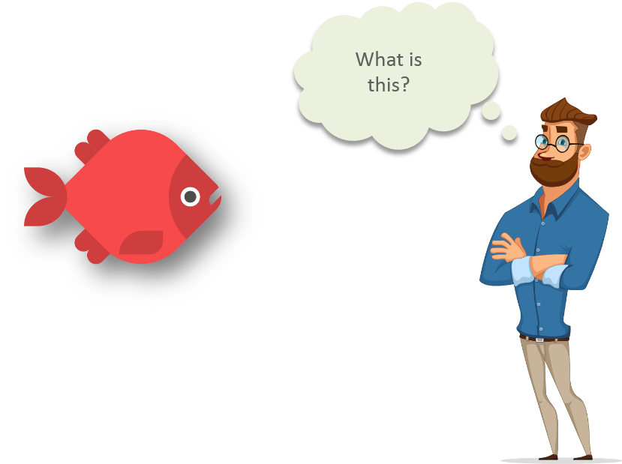
Machine Learning
Intellpaat: https://www.quora.com/What-are-prerequisites-to-start-learning-machine-learning

Slide 13
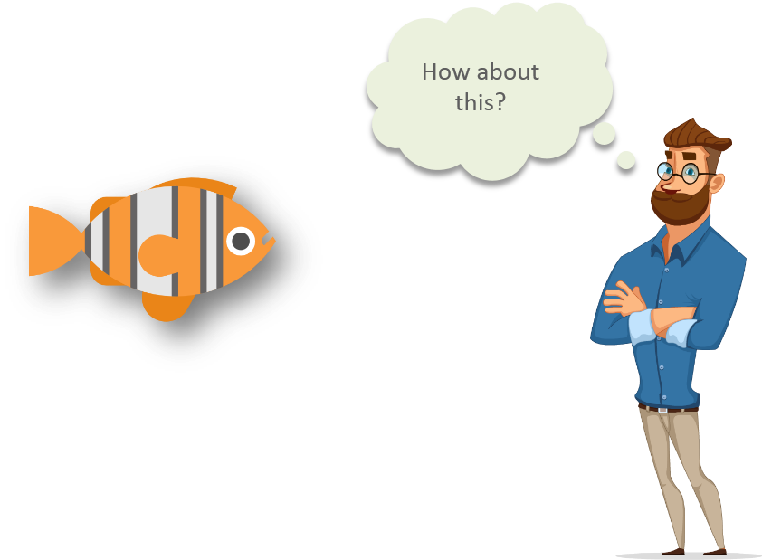
Machine Learning
Intellipaat: https://www.quora.com/What-are-prerequisites-to-start-learning-machine-learning

Slide 14
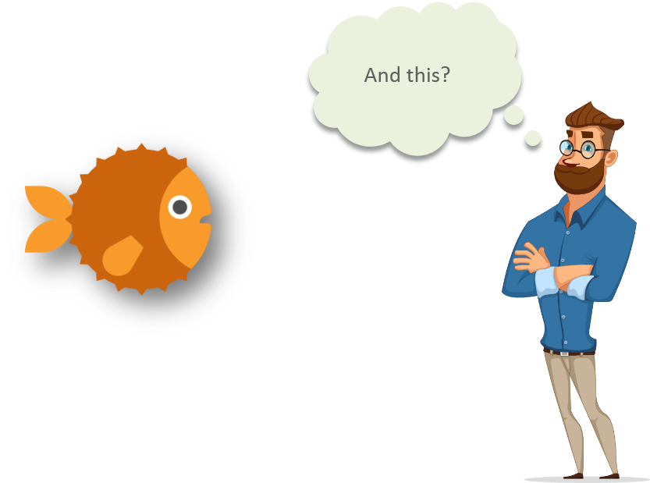
Machine Learning
Intellipaat: https://www.quora.com/What-are-prerequisites-to-start-learning-machine-learning

Slide 15
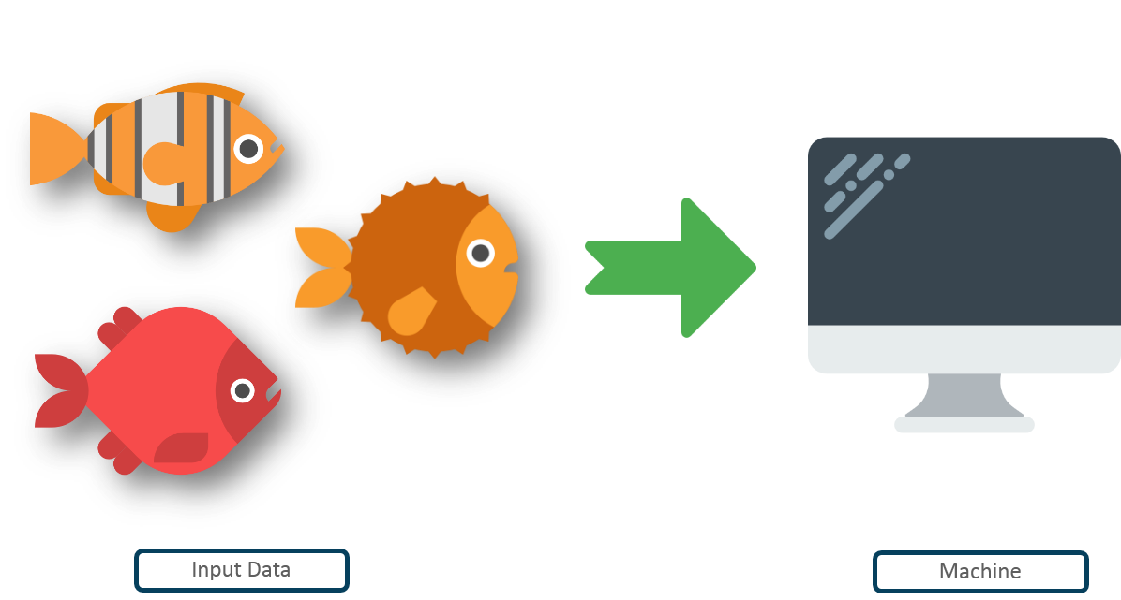
Machine Learning
Intellipaat: https://www.quora.com/What-are-prerequisites-to-start-learning-machine-learning

Slide 16
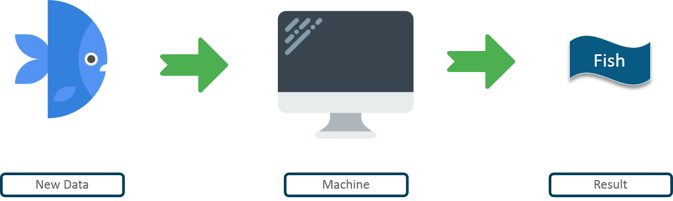
Machine Learning
Intellpaat: https://www.quora.com/What-are-prerequisites-to-start-learning-machine-learning

Slide 17
Machine learning
Machine learning is getting computers to program themselves.
If programming is automation, then machine learning is automating the process of automation
Traditional Programming
Machine learning
Data
Program
Output
Data
Output
Program
Computer
Computer

Slide 18
Pre-Requisites of ML
A Pattern should exist
Mathematical model / algorithm is unknown
Lots of data

Slide 19
Types of Machine Learning
Machine
Learning
Supervised
(Task based)
Unsupervised
(Data Driven)
Reinforcement
(Algorithms learns to react to an environment)
Classification
Regression
Clustering

Slide 20
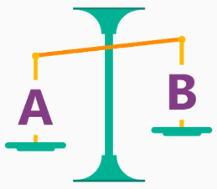
Is it A or B?
Classification Algorithm
Will this tire fail in the next 1,000 miles : Yes or No ?
Which brings in more customers: a $5 coupon or a 25% discount ?

Slide 21
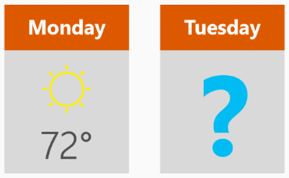
How much? How many?
Regression Algorithm
What will the temperature be next Tuesday?
What will my fourth quarter sales be?
They help answer any questions that asks for a number

Slide 22
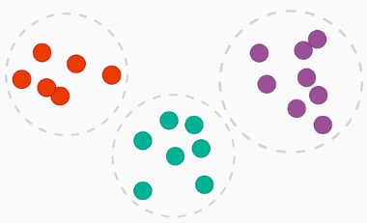
How is this organized?
Clustering Algorithm
Which viewers like the same type of movies?
Which printer model fail the same way?

Slide 23

What should I Do now?
Reinforcement learning Algorithm
If I'm a self-driving car: At a yellow light, brake or accelerate?
For a robot vacuum: Keep vacuuming, or go back to the charging station?

Slide 24
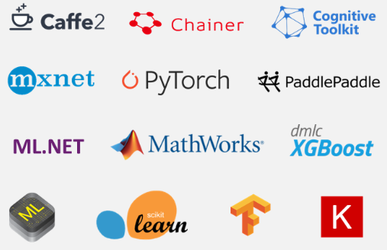
ML Frameworks

Slide 25
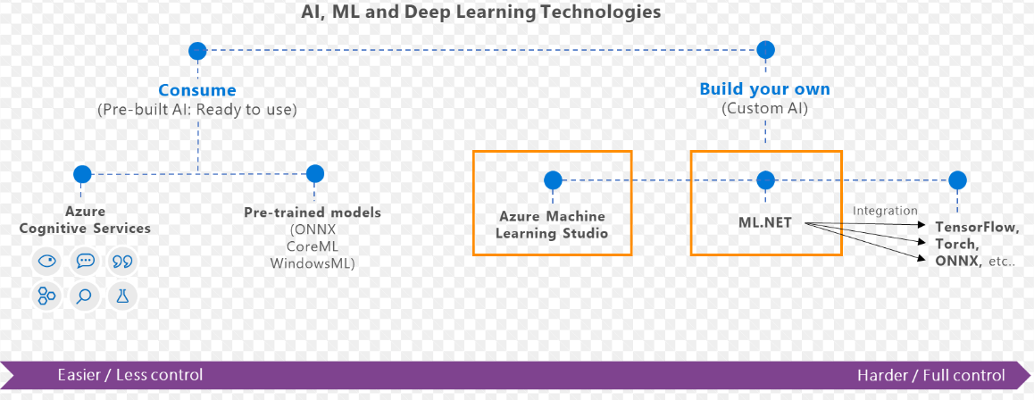
What is ML.Net?
ML framework from Microsoft for developing Custom AI/ML applications
Originated in 2002 as part of Microsoft Research project

Slide 26
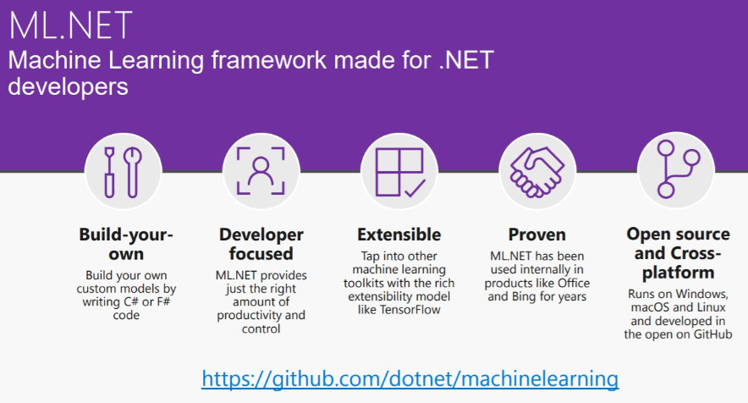

Slide 27
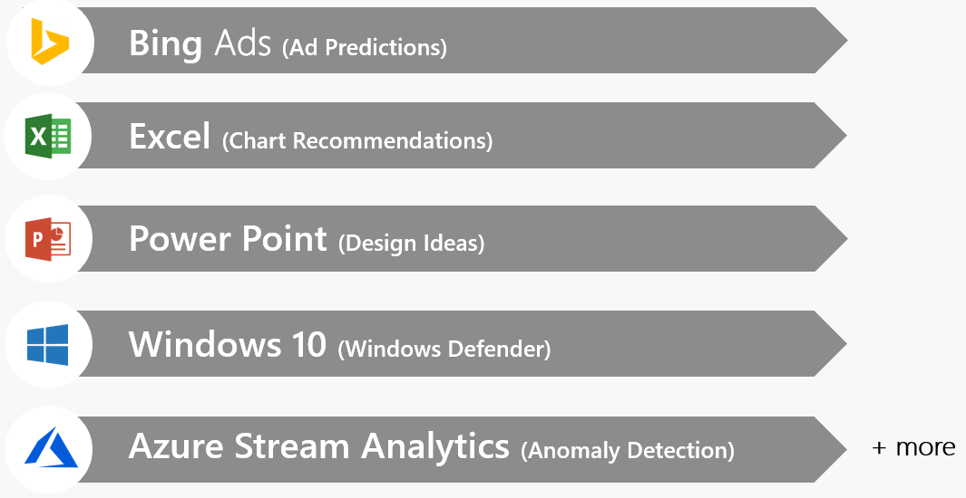
Proven at scale, Enterprise ready

Slide 28
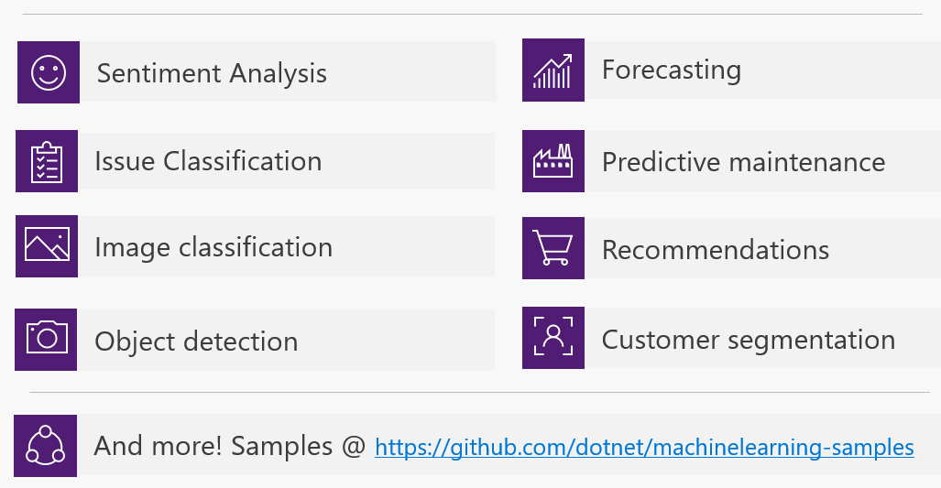
Possibilities

Slide 29
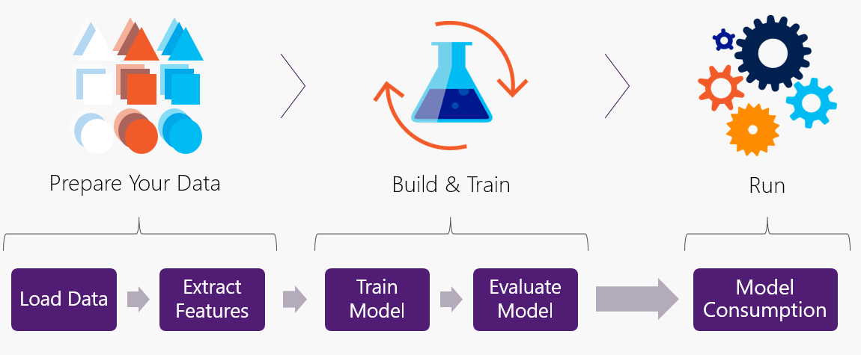
Workflow

Slide 30
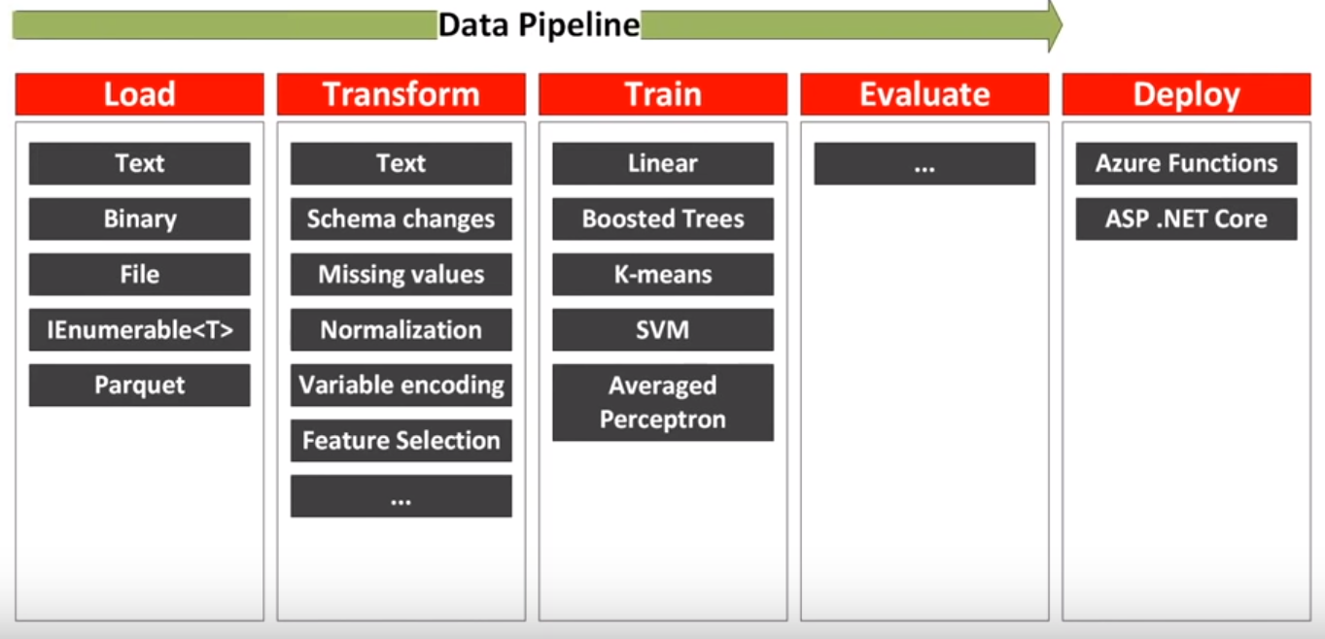
Data pipeline

Slide 31
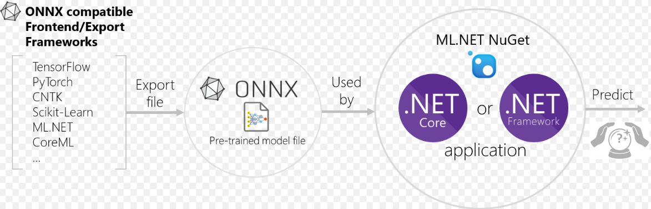
Interoperability: ONNX Open Neural Network Exchange Format
ONNX is developed and maintained by a community of partners such as Microsoft, Facebook.
ONNX files could be viewed using Netron

Slide 32
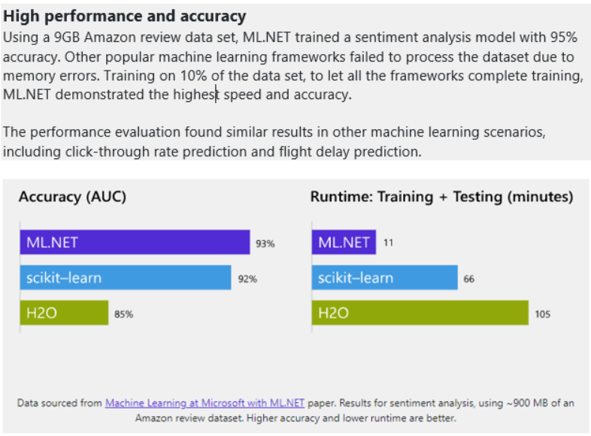
Performance

Slide 33
Code Demo(s)

Slide 34
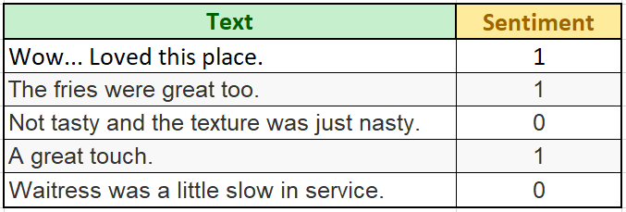
Sentiment Analysis
Positive(+ve) , Negative(-ve)
Label and Features
Train model using ML.Net
Train using AutoML
Code generation
Accuracy improvement
https://docs.microsoft.com/en-us/dotnet/machine-learning/tutorials/sentiment-analysis

Slide 35
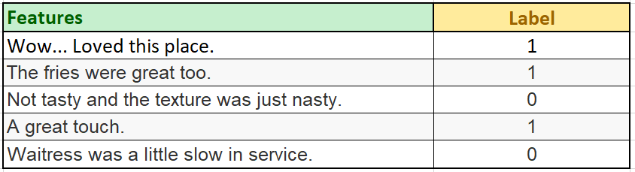
Dataset - Yelp reviews

Slide 36
Load
// Initialize ML Context
MLContext mlContext = new MLContext();
// Load : Split it into 80% training and 20% test data
var trainTestSplit = 0.2;
IDataView dataView = mlContext.Data.LoadFromTextFile<SentimentData>(_dataPath, hasHeader: false);
TrainTestData splitDataView = mlContext.Data.TrainTestSplit(dataView, testFraction: trainTestSplit);

Slide 37
Load -> Transform
// Transform : Converts the text column(SentimentText) into numeric type Features column using FeaturizeText
var estimator = mlContext.Transforms.Text.FeaturizeText(outputColumnName: "Features", inputColumnName: nameof(SentimentData.SentimentText))
.Append(mlContext.BinaryClassification.Trainers.SdcaLogisticRegression(labelColumnName: "Label", featureColumnName: "Features"));

Slide 38
Load -> Transform -> Train
// Train/Fit model
var model = estimator.Fit(splitDataView.TrainSet);

Slide 39
Load -> Transform -> Train -> Evaluate
// Evaluate : Evaluate performance of the model using Test set
IDataView predictions = model.Transform(splitDataView.TestSet);
CalibratedBinaryClassificationMetrics metrics = mlContext.BinaryClassification.Evaluate(predictions, "Label");

Slide 40
Load -> Transform -> Train -> Evaluate -> Predict
// Create PredictionEngine passing above model
PredictionEngine<SentimentData, SentimentPrediction> predictionFunction = mlContext.Model.CreatePredictionEngine<SentimentData, SentimentPrediction>(model);
// Create sample text
SentimentData sampleStatement = new SentimentData
{
SentimentText = "This was a very bad steak"
};
// Predict
var resultPrediction = predictionFunction.Predict(sampleStatement);

Slide 41
Load -> Transform -> Train -> Evaluate -> Predict -> Save
// Save Model
mlContext.Model.Save(model, splitDataView.TrainSet.Schema,"model.zip");

Slide 42

Binary Classification
Titanic - Survival Prediction
Label and Features
Train model using ML.Net
Train using AutoML
Code generation
Accuracy improvement
Data: https://web.stanford.edu/class/archive/cs/cs109/cs109.1166/problem12.html

Slide 43
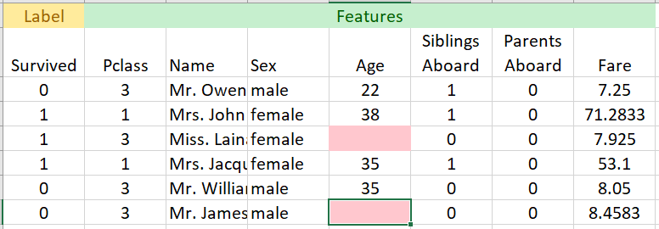
Titanic Data

Slide 44
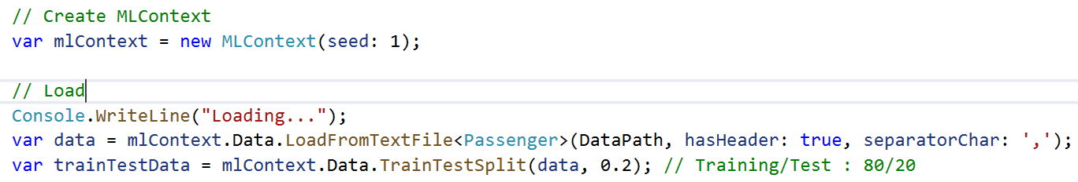
Load

Slide 45
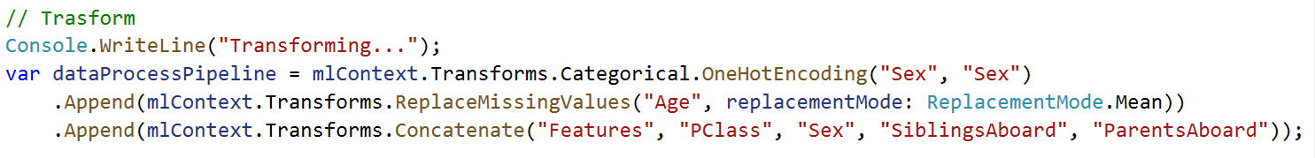
Load -> Transform

Slide 46
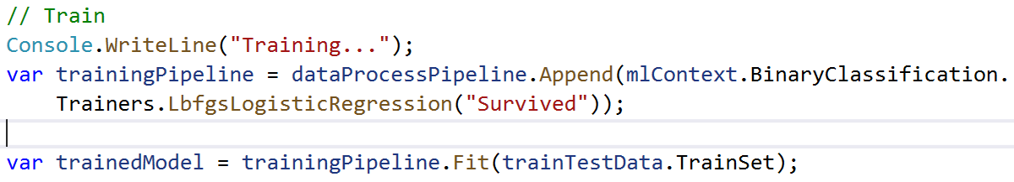
Load -> Transform -> Train

Slide 47
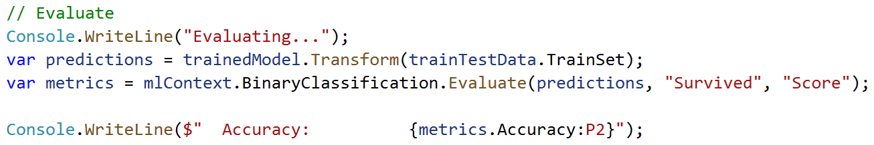
Load -> Transform -> Train -> Evaluate

Slide 48
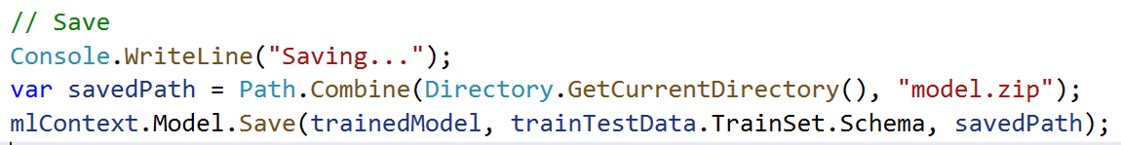
Load -> Transform -> Train -> Evaluate -> Save

Slide 49
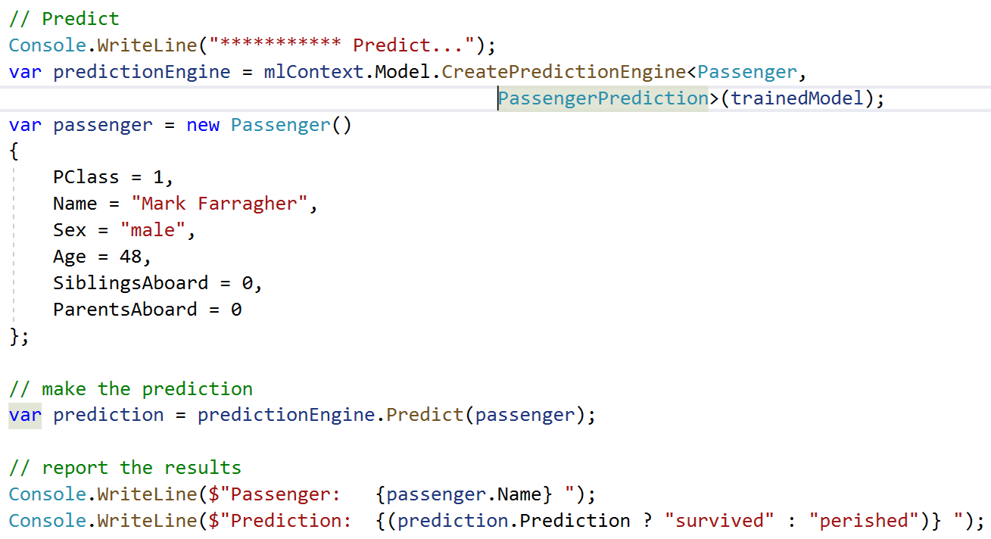
Load -> Transform -> Train -> Evaluate -> Save -> Predict

Slide 50
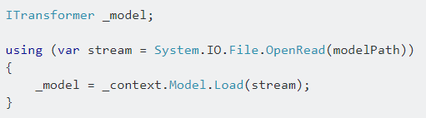
Load a model

Slide 51
AutoML – In Preview
S.No | Custom ML | AutoML
1. | Manually experiment with different algorithms | Runs different algorithms
2 | Time consuming in identifying best algorithm | Runs many algorithm without code changes
3 | Provides better control of algorithms | No control over algorithm selection
4 | Manually write code | Auto-generates code
mlnet auto-train --task binary-classification --dataset "titanic.csv" --label-column-index 0 --has-header true --max-exploration-time 30

Slide 52
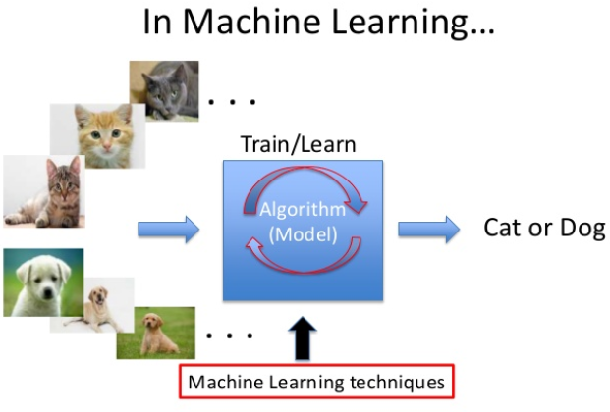
Interoperability
Photo-Search
ML.Net + ONNX
Keras CNN Model
No rewrite of algorithms/model
Save effort and time

Slide 53
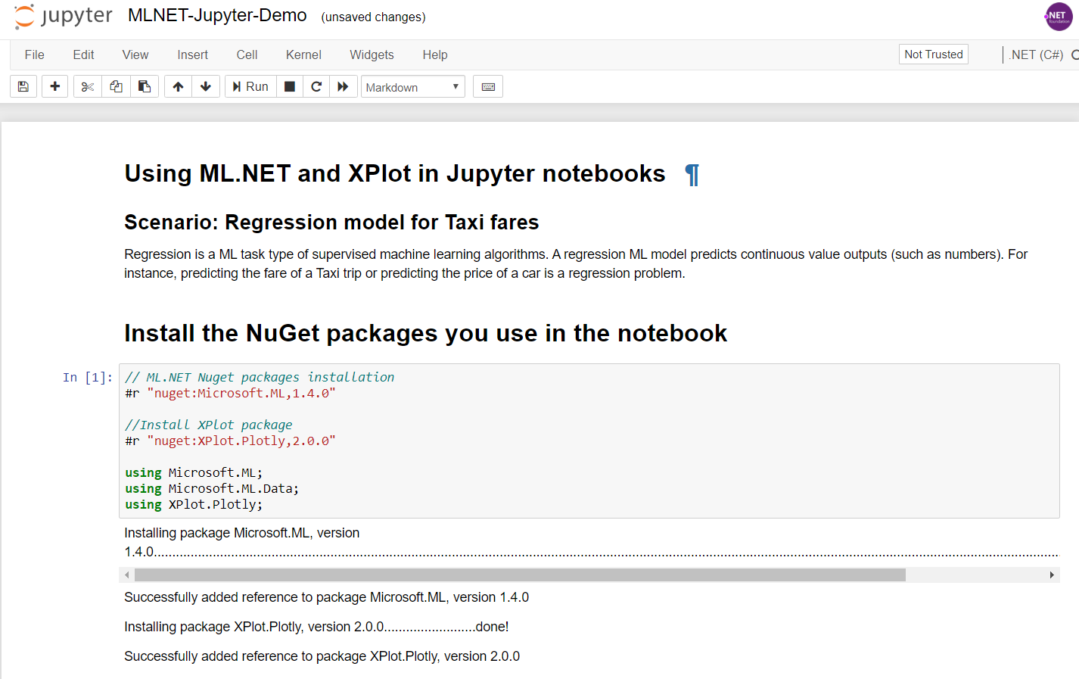
Jupyter Notebook – C#/F#
https://devblogs.microsoft.com/cesardelatorre/using-ml-net-in-jupyter-notebooks/

Slide 54
References
ML.Net : https://dotnet.microsoft.com/apps/machinelearning-ai/ml-dotnet
ML.Net: https://devblogs.microsoft.com/cesardelatorre/what-is-ml-net-1-0-machine-learning-for-net/
ONNX : https://onnx.ai/
Photo-Search (ONNX) : https://github.com/Tak-Au/Photo-Search
Music Repair : https://www.youtube.com/watch?v=nnV-1q-z9uE
ML Cookbook : https://github.com/dotnet/machinelearning/blob/master/docs/code/MlNetCookBook.md
Deploy to Azure functions : http://luisquintanilla.me/2018/08/21/serverless-machine-learning-mlnet-azure-functions/
https://rubikscode.net/2019/02/18/ultimate-guide-to-machine-learning-with-ml-net/
https://www.youtube.com/watch?v=dojO4zEL9sg
https://www.youtube.com/watch?v=zy7Y9CHji2k

Slide 55




Thank you Q & A
praveenraghuvanshi@gmail.com
https://in.linkedin.com/in/praveenraghuvanshi
https://github.com/praveenraghuvanshi1512
@praveenraghuvan

